Slide 1
Ministry Mystery
Rev. Dr. Martha Creek
www.marthacreek.com
Notes:
KEYNOTE TUESDAY

Slide 2
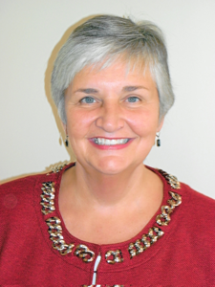
Rev. Dr. Martha Creek
Experience and Credentials
Served UWSI Faculty, GLURC Regional consultant Regional Keynote Presenter, Served 200 Unity ministers and ministries for 25 years
Healthy Congregations Facilitator and Trainer
Lombard Mennonite Peace Center, Clergy Clinic, Church Conflict, Mediation Skills Training, Conflict Resolution
Nine Gates Mystery School Staff
Hoffman Institute Graduate
Vipassana Graduate and Staff
Ordained in Religious Science, Divine Science
Affiliated New Thought Network Conference Chair
Notes:
“that’s what presenters usually do to get you interested in listening to them … but if you actually do listen to me today, at the end you’ll be asking ‘where did she learn all that stuff!”

Slide 3
12 Disruptive Church Trends That Will Rule (and The Post-Pandemic Era) * source: Carey Nieuwhof
1

Slide 4
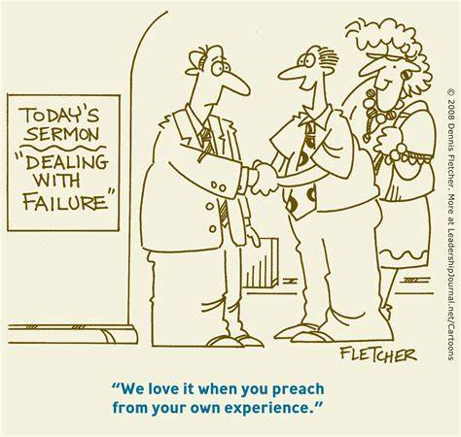
1. The Demise of the Old Model of Church
Notes:
Every church and every leader has a model of Church. Even those who claim they don’t have a model, have a model (their anti-model is the model).
A model is simply an approach—a strategy, a way of doing things.
The old model of Church has been proving less effective year by year for decades across almost all denominations and traditions.
In 2021, Gallup shared that for the first time ever, church membership dropped below 50% nationally. Among Millennials, only 36% identify with a church.
Similarly, a decade ago only 22% of Millennials said they have no religious affiliation. Today that number is 31%. For
Gen Z, 33% now say they have no religious affiliation.
At the same time, attendance keeps dropping across the board.
A survey by FACT of over 15,000 churches conducted just before COVID hit shows that between 2000 and 2020, median church service attendance dropped from 137 people to 65.
2022 should start to yield data on where things stand now, and as you already suspect, the new data is highly likely to show further decline. In other words, even if your church returns to 2019 attendance levels or exceeds them, the overall decline in church attendance will continue unabated.
So, what does this mean?
The current approach to church not only isn’t effective, it hasn’t been effective for decades. Yet leaders keep moving forward as though somehow things are going to turn around.
Optimism is one thing. Delusion is another.
The death of an approach to church doesn’t equal the death of the Church. Changing the approach is the best way to begin to see new growth.
Wise leaders will become students of what’s happening and seek to find a new approach that’s biblically faithful and culturally effective.
Rightly or wrongly, they’re deciding how and when to engage with church, and they’re voting with their feet and wallets.
Adept leaders will figure out where culture is going, figure out how to meet people where they’re at, and then lead them to where they need to be.
What was is gone. What will be hasn’t yet emerged.
The key is to experiment.
Stay faithful to Biblical principles.
Experiment with the practice.
Study your people.
Study the culture.
Lead people where they need to go.
The task, in other words, is to devise a faithful approach to Church that will reach and disciple the next generation.
In the future Church, leaders who are willing to change their methods will amplify their mission. Leaders who don’t, won’t.

Slide 5
2. Growing Churches Will Innovate Beyond Weekend Services
Notes:
As leaders rethink the model of Church, more church leaders will start rethinking the role of weekend services.
Don’t get me wrong. Weekend services are extremely important for a host of theological reasons (and a few practical ones, as well).
But for many churches, the weekend service has become either all the church does or the main focal point by which everything else revolves.
Focusing all your efforts on one hour on Sunday ignores the other 167 hours in a week.
Many churches function like restaurants that decide that if you want to eat, it can only happen in a one-hour window and only in this particular building, and if you miss it, you miss it.
Think about it. What future would there be for a restaurant whose mantra is:
You can only eat food in our building?
We’re only open one hour a week?
We don’t do much in between?
Naturally, Church is a lot more than one hour of performance or participation on Sunday morning (a little harsh, but that’s what it’s become in some cases).
A lot of the innovation that has to happen in the Church needs to take place outside of Sunday and outside the building.
People don’t live in your church building. They live in the community, where they interact with MANY others/different
Churches that equip people where they live and work will start to grow. And yes, that requires innovation.

Slide 6
3. The Vision for the Future Will Become Clearer
Notes:
Not all churches will find a new vision, but those who do will have a brighter future.
Ironically, as you know, the vision for the future has been there all along because the vision of the Church doesn’t change that much. The core of the Church’s vision is always evangelism and discipleship.
It’s just that with all the noise, panic, confusion, and hardship of the past two years, it’s been exceedingly hard to focus on anything else.
In 2022, at least among a small group of church leaders, the vision for the future Church will become louder than the lethargy of the present or the anger of the dissenters. And they’ll start growing. They will experiment.
Find a new approach that’s resonating; and begin to reach new people.
Some of them will be bold experimenters. And they’ll receive a lot of criticism for their experimentation as they create a new approach—a new model for church.
Many of the ideas you’ll see in the Church in 2022 will be criticized and dismissed—until they’re not.
But that’s how innovation works. The leaders we criticize today will be the leaders who coach us tomorrow.

Slide 7
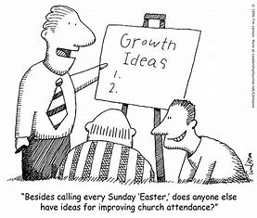
4. Attendance Will Normalize
(and You’ll Have
a New Church)
Notes:
2021 had many leaders clinging to the idea that the next season – Easter, the new school year, Christmas, etc. – would bring attendance back to 2019 levels (which wasn’t that great in the first place.
For most churches, that “magic season” never materialized.
Cartoon: “Besides calling every Sunday ‘Easter,’ does anyone else have ideas for improving church attendance?”
In 2022, the constant cycle of hope and disappointment will give way to the new reality that this is your church.
It will become evident that some of the people who said they’re coming back later clearly aren’t coming back—ever.
But it’s not all bad news.
When you look around, you’ll see a lot of new people who have joined you because they found you online or a friend brought them.
You’ll get to know your online audience like they’re real people (because they are).
And potentially, you’ll start to notice small pockets of momentum and hope. Build on those.
Regardless, you’ll settle into the reality that, for better or worse, this is your church. These are the people you will build the future alongside.
Which is just in time. You can’t build the future of your church when you’re living in the past.

Slide 8
5. Hybrid Church Will Simply Become Church
Notes:
The debate between in-person church versus online church has always been somewhat of a false one.
But 2022 is the year where the hybrid-church model will simply become church. In other words, hosting church online and in-person is just how you do church to reach the next generation.
People have lived in the slipstream of digital and in-real-life for well over a decade now, and church leaders will realize that church online is both a necessity and an opportunity.
It’s good that the debate over online church will fade into the background because then leaders can get on with the key task: Reaching people however they come to you—in person or online.

Slide 9
6. In-Person Will Become More Personal
Notes:
The future is both deeply digital and deeply personal.
Increasingly though, as people show up for in-person events, they’re expecting more personal experiences.
Before the pandemic, a look at culture shows a rise in bespoke, custom, private, and VIP services at everything from concerts to clothing stores to vacations. That will accelerate in the post-pandemic world.
It is vital to figure out how to care for people personally – to know their names, to care about them as people. And for ministry, that’s always been important.
But for larger churches in particular, dehumanizing systems that make people feel unnoticed will be tolerated less and less. No one wants to be a number. In the future, treating people like numbers will get you declining numbers and not much more.
Even in small churches, it’s easy to ignore the people, thinking that your church is friendly simply because you know six people (but don’t even know the names of the other 40 people who worship with you).
The goal is not to have a church where everyone knows everybody (that doesn’t scale). The point is to have a church where everyone is known.

Slide 10
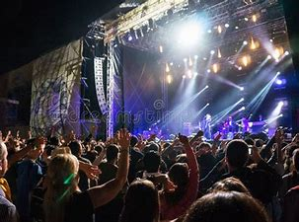
7. Information Will Move
Online and Transformation
Will Move to In-Person
Notes:
For a few years in this Church trends series, I’ve flagged the longing people have for non-downloadable experiences when they show up for church in person.
In 2022, many church leaders will likely realize that the best lane for information is online,
while more transformational, transcendent experiences are more likely to happen in-person.
They’ll design their online ministry and in-person experiences accordingly.
It’s not that people can’t come to faith online (they can and do); it’s just that there’s a difference between the kind of experience you can have on a device versus what you can experience in the room.
It’s like the difference between listening to an album on Spotify and seeing it perform live at a concert. The in-person experience leans more toward that transcendent moment than simply listening to a studio recording alone in your car.
Online might become more transcendent as virtual reality becomes more widespread, but we’re a few years and tech iterations away from that.

Slide 11
8. Location-Independent Church Members Will Increase
Notes:
The last few years have seen a mass migration of people out of cities, out of jobs they once held, and into new frontiers.
With that, those who remain in church have discovered church online.
While a lot of digital growth is likely,
the physical relocations combined with the growth of digital church will find many people identifying with a church that has no physical location in their area.
This will lead to micro – think home-based – gatherings and the need for church leaders to focus on connecting people, not just erecting buildings to put them in
Location independence is part of the fluid world we now live in. Leaders who adapt quickly will reach more people.

Slide 12
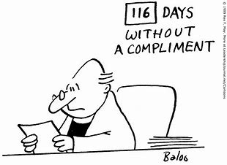
9. Pastors Will Sense A Diminished Authority
Notes:
We’ve seen significant shifts in authority over the years.
As the world has become more connected, power has shifted from institutions to networks.
Denominations and seminaries have lost much of the clout they used to have, and grassroots networks have sprung up in their place,
it’s no longer just denominations and seminaries that have lost authority, so have pastors.
As any church leader knows, any illusion of control that remained seems to have vanished during the pandemic. You can’t control people.
No matter how loudly or softly you speak, people won’t listen because of the position, title, or office you hold.
The good news is that this is never where real authority resided anyway.
One of the things that defined Jesus’ ministry was that his authority never sprung from an (earthly) title he held, nor did he cling to power.
Real authority doesn’t spring from an office, a title, or power.
It springs from humility, love, and a clear sense of how the Kingdom of God is advancing in the world.
Leaders who show those kinds of characteristics will have a bright future.

Slide 13
10. The Brain Drain
Will Become
Acute
Notes:
Sadly, the last few years have seen many pastors step back, not just from their current church but also from vocational ministry.
Whether the Great Resignation has more legs or not in the wider culture, the Church has struggled through a more chronic gifting shortage for years now. The pandemic only intensified that.
Not only is this creating a staffing shortage (more churches vying for fewer leaders), but the quality of candidates is also proving a bit of a challenge.
Perhaps renewal and revival will increase intensity in the sense of the calling the next generation has, but we’re not seeing the fruits of that labor yet.
The future Church will require leaders with great hearts and leaders with great minds.
The challenges ahead in a fractured world facing numerous existential threats (not to mention the philosophical and theological questions artificial intelligence raises) will require some very sharp minds.

Slide 14
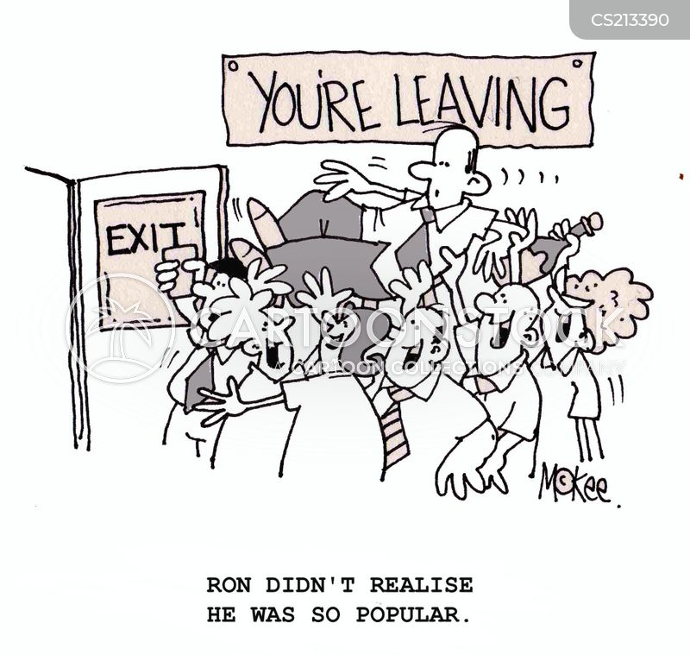
11. The Exit
of
Uninvested
Investors
(A Recalibration in Giving)
Notes:
One of the strange phenomena that happened in many churches in 2020-2021 is that attendance declined while giving remained steady or grew.
My guess is that this might be a temporary trend.
Historically, declining churches tend to have a lot of money (think endowments) but few people, while growing churches tend to have a lot of people but are tight on money. Their numerical growth has outpaced their stewardship growth.
That recent change in the historical pattern can be explained by donors who did financially well in the pandemic contributing extra and people who are still committed financially but hesitant to attend in person still giving.
But, ultimately, it’s rare to have uninvested investors. If someone stops attending, stops serving, and cuts off connection with a church, will their giving continue?
What you might see this year is a ramping up of new people who start to give while uninvested investors disappear entirely.
Second, church leaders will have to find something to do with their accumulated surplus to further the mission. Otherwise, why would people keep giving?
Money with no purpose is a sign of decline.
Regardless, it’s unlikely the current pattern will hold.

Slide 15
12. Less Predictability
Notes:
Finally, as much as we all long for a return to a more stable, predictable future, that’s likely not happening. As much as we can plot out a few likely trends (which is what this post is trying to do), it’s still uncertain what’s ahead.
As COVID-19 fades, we enter into a new era of instability and unpredictability, which most of us have never known in our lifetime.
The global supply chain issues, the surge in the gig economy, shortage in blue-collar and service sector workforce, surging stocks, the rise of cryptocurrencies, the exit and entry of people in and out of church in rapid numbers, growing inflation, and the widespread drop in confidence in institutional authority make it exceedingly difficult to trace out a predictable path into the future.
Once again, the approach that got many leaders through the pandemic (flexibility and agility) will be required for years to come.
The ‘set it and forget it’ approach to leadership that worked in stable times/ areas won’t work anymore.
However, agile leaders and organizations that love to experiment and innovate can thrive in an unstable world.

Slide 16
Resources
https://churchanswers.com
https://careynieuwhof.com
https://www.barna.com/stateofthechurch
https://emotionallyhealthy.org
Books: Emotionally Healthy Spirituality; Emotionally Healthy Leader
https://margaretmarcuson.com
Books: Leaders Who Last: Sustaining Yourself and Your Ministry
https://unity.org
https://unityworldwideministries.org/ ministry-leadership-board-resources

Slide 17
Seven Traits of Pastoral Ministry for the Future

Slide 18
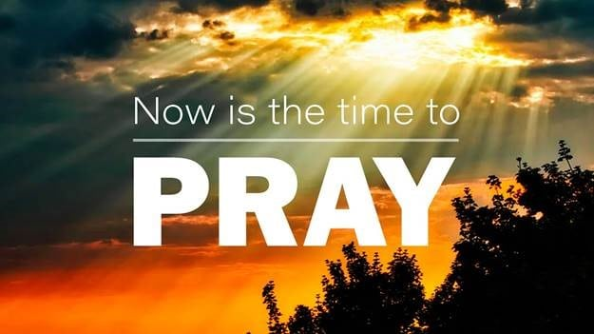
1. Do not forsake the importance of prayer.
Be a Leader who Prays. Pray personally. Lead churches to embrace the importance of prayer.
“AND, we will steadfastly continue in prayer and the ministry of the word.” — Acts 6:4
Prayer is a true reflection of your leadership approach and priority.
Notes:
“Keep on praying in faith, it is through prayer that you develop all your wonderful qualities of soul.” — Myrtle Fillmore

Slide 19
2. Prioritize evangelism.
Jesus commanded us to be witnesses (Acts 1:8). “You will receive power when the Holy Spirit comes on you, and you will be my witnesses, to the ends of the earth.”
“Let the God within you express itself through you in the world without.” — Charles Fillmore
Notes:
Share the good news of Christ/
Unity/A Positive Path for Spiritual Living.

Slide 20
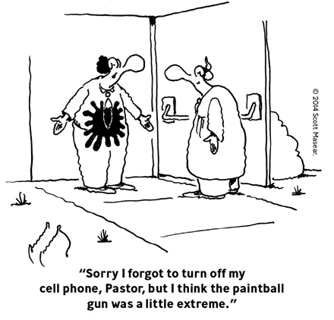
3. Deal with toxicity promptly.
I have never known a pastor that confronted toxic members in the
church who thought it was done
too quickly. The typical response:
“I should have done this a long
time ago.”
“Tell the truth and tell it quick.” — Edwene Gaines

Slide 21
4. Have Grit.
Serving ministry is tough work. Thriving pastors are persistent; have tenacity; and grit.
“I stayed when I didn’t want to; and stayed when they didn’t want me to.” Karen Lindvig (Sr. Minister Unity of Seattle) serving decades as pastor.

Slide 22
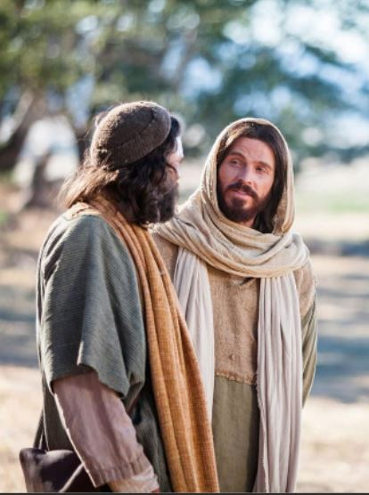
5. Love Your Community More Deeply.
Serve and reach the congregants and community more urgently and directly.
The pastors who succeed five years from now will have deeply connected to the communities in which their churches are located.

Slide 23
6. Rediscover Joy.
Ministry can seem like it’s one critic and naysayer after another. Successful pastors five years from now will still see the joy of their calling every day. They might even discover a bit more levity.

Slide 24
7. Take Faith Risks.
We know we can not plan everything. We understand we have to expect the unexpected.
We know we have to lead our churches into new and exciting areas and endeavors.

Slide 25
Who will be around and thriving in ministry in 2030?
How will you sustain yourself for the next 5 years?
Notes:
I am willing to say with some confidence that it will be pastors who have these seven traits.

