Slide 1
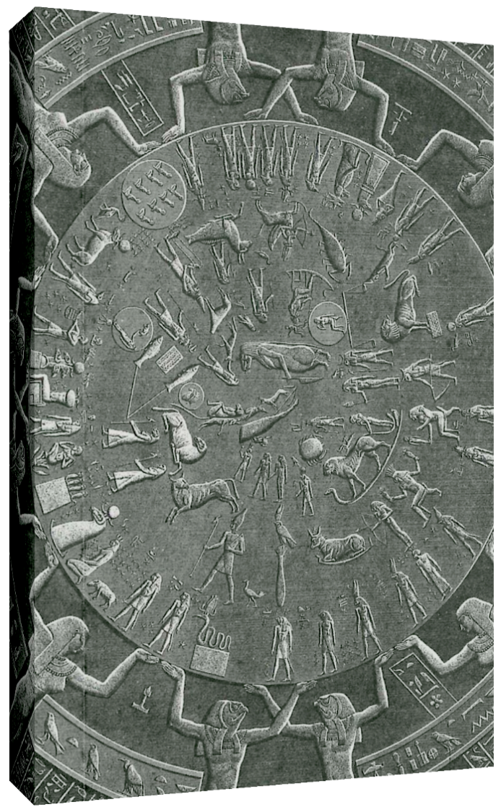
same story
Freyja
White Buffalo
Calf Woman
Registration Optional
lord
isis
in the
bible
Eris
Al-Buraq
Persephone
Maa-Durga
we are 1
Isis
Phoenix Rising
April 15th, 2023
Madonna
Quan Yin
Mictecacihuatl
10 weeks of Wednesdays
3:33 p.m. - 5:00 p.m. EST
Starts May 1st, 2024
Every Week is different
(no prerequisites)
Kali
Ereshkigal
Same in every culture!!!
Mother who saves her Sun/Son…
You!!!
Link in Description
same land

