Slide 1
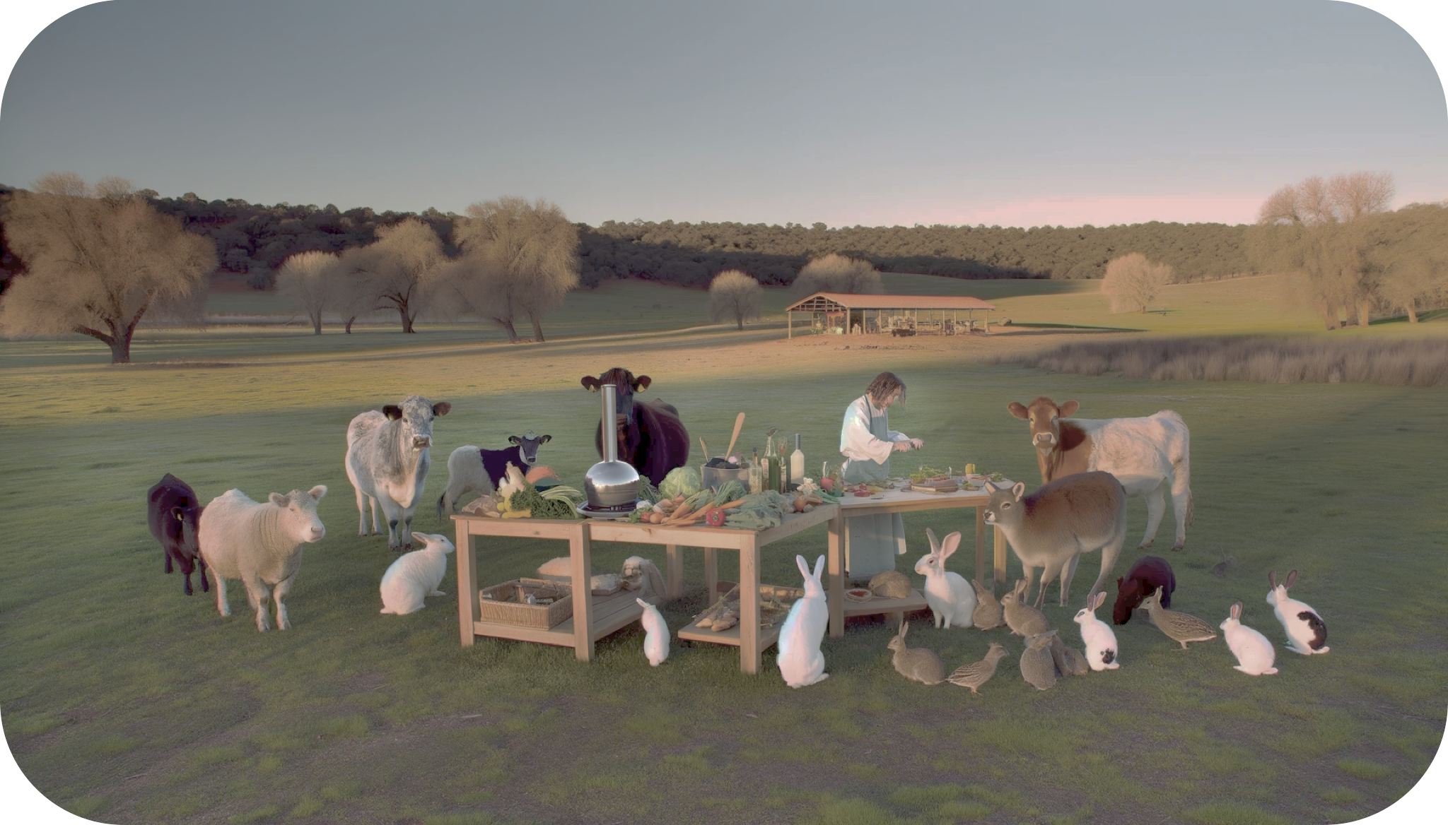
Cooking & Laughing
with Claudio & Bob
Everybody is Happy
Everybody is Healthy…
Fun & Delicious!

